Slide 1
Algorithms week 1: Introduction Descriptive Statistics
Jonathan Stray
Columbia Lede Program
July 18, 2018
Notes:
To open: https://mathwithbaddrawings.com/2016/07/13/why-not-to-trust-statistics/

Slide 2
Algorithms in journalism

Slide 3
LAPD Underreported Serious Assaults, Skewing Crime Stats for 8 Years
Los Angeles Times, 2015
Notes:
http://www.latimes.com/local/cityhall/la-me-crime-stats-20151015-story.html

Slide 4
Technical troubles with a new system meant that almost 70,000 North Carolina residents received their food stamps late this summer. That’s 8.5 percent of the number of clients the state currently serves every month. The problem was eventually traced to web browser compatibility issues. WRAL reporter Tyler Dukes obtained 4,500 pages of emails — on paper — from various government departments and used DocumentCloud and Overview to piece together this story.
https://blog.overviewdocs.com/completed-stories/
Notes:
https://blog.overviewdocs.com/completed-stories/

Slide 5
Overview’s “topic tree” (unsupervised TF-IDF clustering) used to find a group of key emails from a mailing list (Tyler Dukes / WRAL)
Notes:
https://blog.overviewdocs.com/completed-stories/

Slide 6
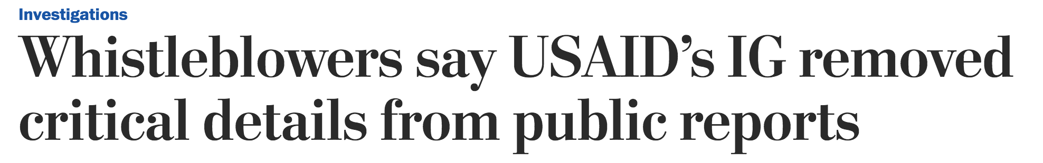
The Post obtained draft versions of 12 audits by the inspector general’s office, covering projects from the Caribbean to Pakistan to the Republic of Georgia between 2011 and 2013. The drafts are confidential and rarely become public. The Post compared the drafts with the final reports published by the inspector general’s office and interviewed former and current employees. E-mails and other internal records also were reviewed.
The Post tracked changes in the language that auditors used to describe USAID and its mission offices. The analysis found that more than 400 negative references were removed from the audits between the draft and final versions.
Sentiment analysis used by Washington Post, 2014
Notes:
https://www.washingtonpost.com/investigations/whistleblowers-say-usaids-ig-removed-critical-details-from-public-reports/2014/10/22/68fbc1a0-4031-11e4-b03f-de718edeb92f_story.html

Slide 7
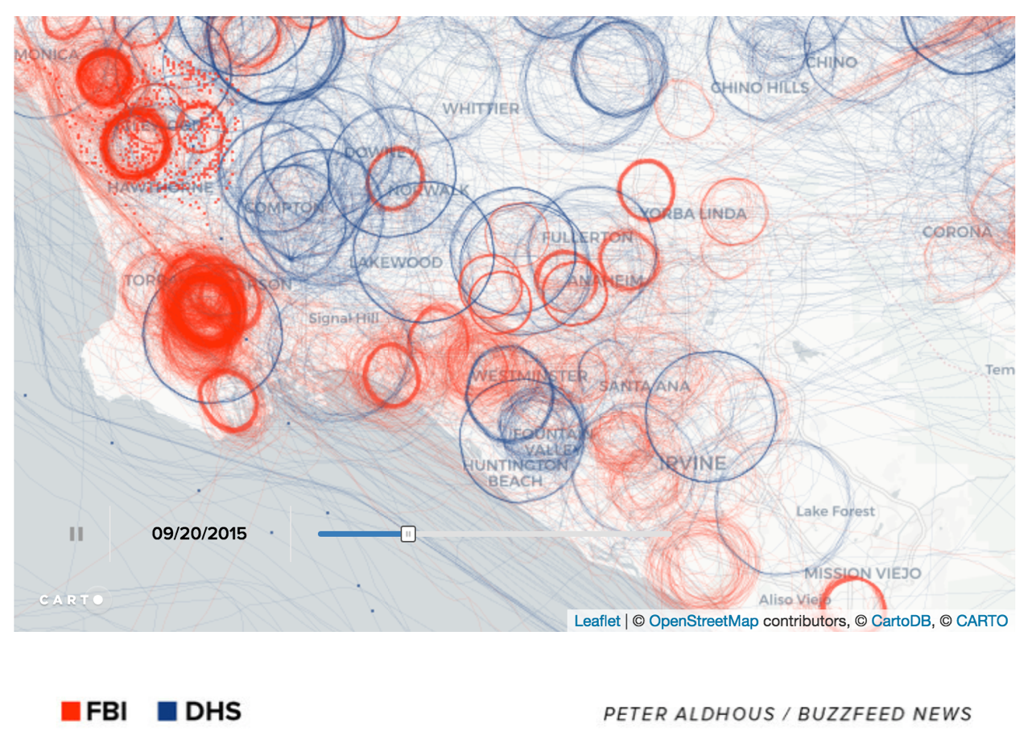
U.S. government surveillance planes identified by machine learning on flight path data (Peter Aldhous/Buzzfeed)
Notes:
https://www.buzzfeed.com/peteraldhous/spies-in-the-skies?utm_term=.taPrVQWez#.hede9d6ZL

Slide 8
Journalism on Algorithms

Slide 9
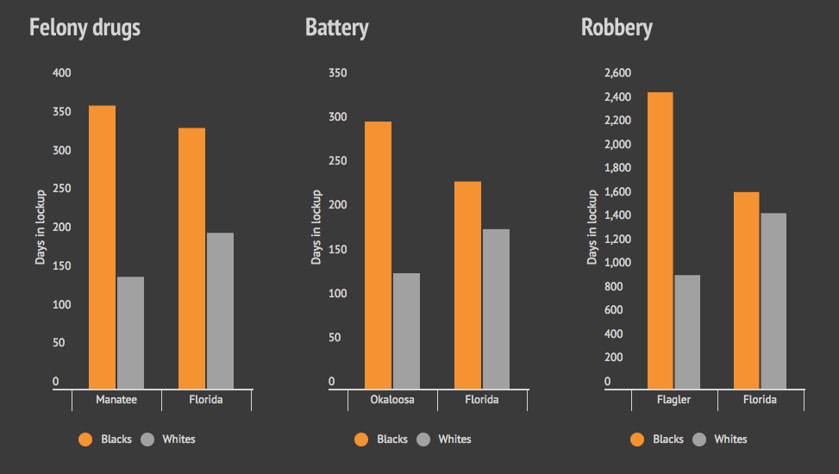
Florida sentencing analysis adjusted for “points”
Bias on the Bench, Michael Braga, Herald Tribune
Notes:
http://projects.heraldtribune.com/bias/sentencing/

Slide 10
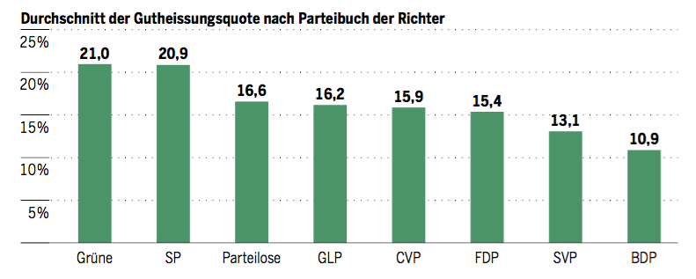
Swiss judges: a natural experiment
24 Judges of Swiss Federal Administrative court are randomly assigned to cases. They rule at different rates on migrant deportation cases. Here are their deportation rates broken down by party.
Barnaby Skinner and Simone Rau, Tages-Anzeiger.
https://github.com/barjacks/swiss-asylum-judges
Notes:
https://github.com/barjacks/swiss-asylum-judges

Slide 11
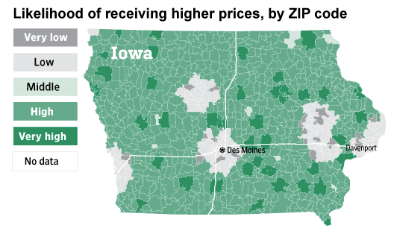
Websites Vary Prices, Deals Based on Users' Information
Valentino-Devries, Singer-Vine and Soltani, WSJ, 2012

Slide 12
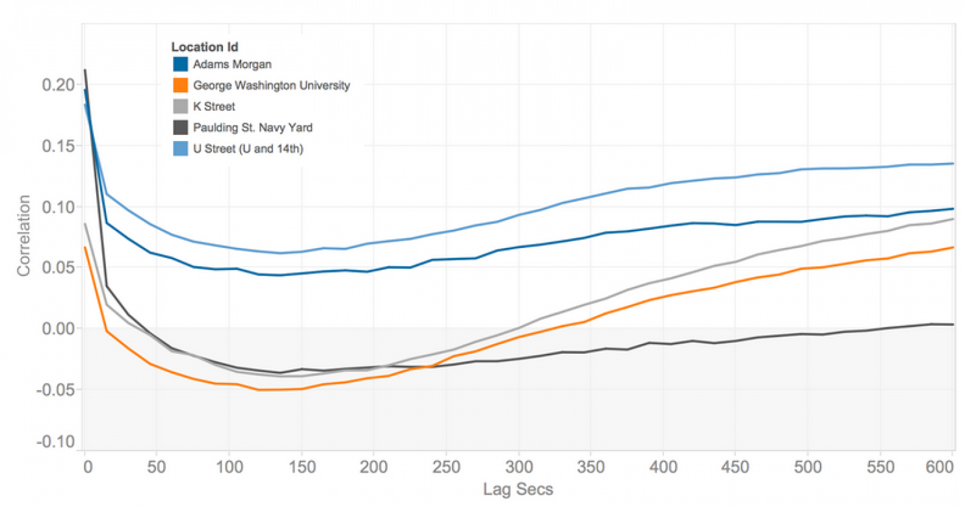
How Uber surge pricing really works, Nick Diakopolous

Slide 13
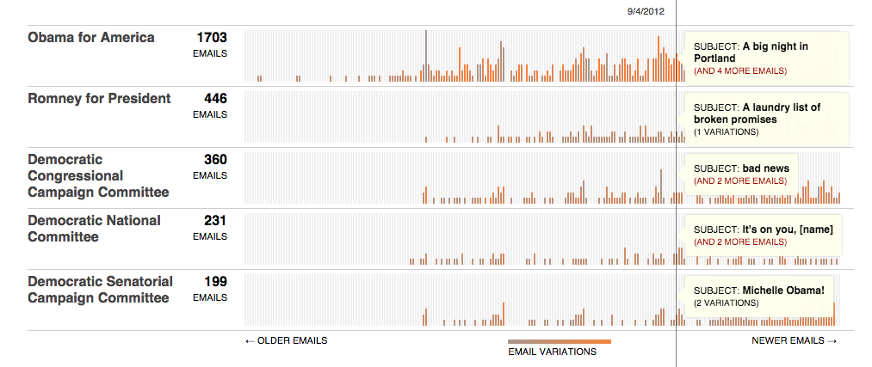
Message Machine
Jeff Larson, Al Shaw, ProPublica, 2012

Slide 14
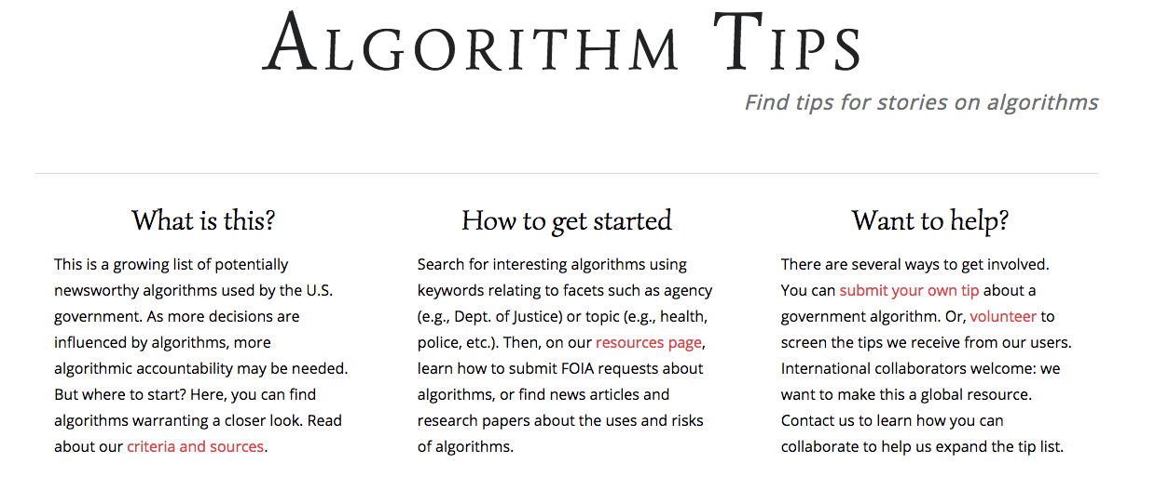
Notes:
http://algorithmtips.org/

Slide 15
Simulation Methods

Slide 16
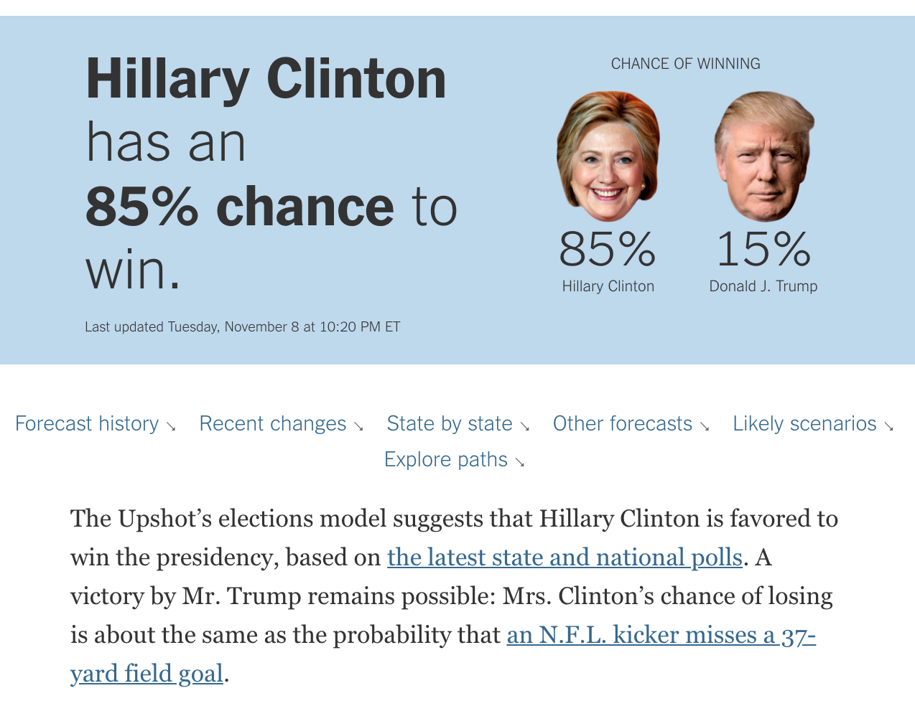
New York Times 2016 Election Predictions
Notes:
https://www.nytimes.com/interactive/2016/upshot/presidential-polls-forecast.html

Slide 17
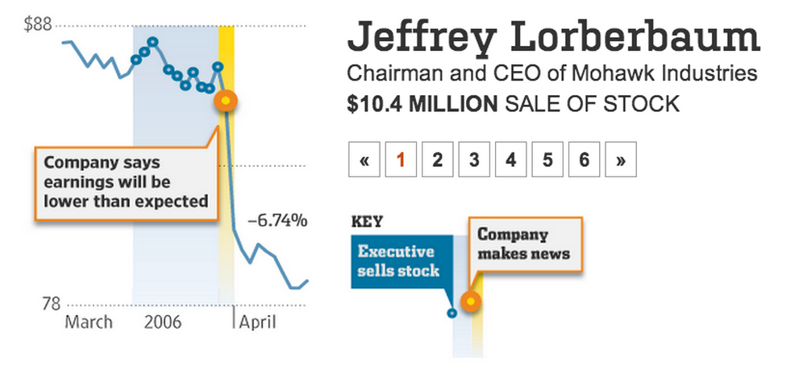
Randomization to detect insider trading
Notes:
http://online.wsj.com/articles/SB10000872396390444100404577641463717344178

Slide 18
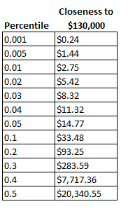
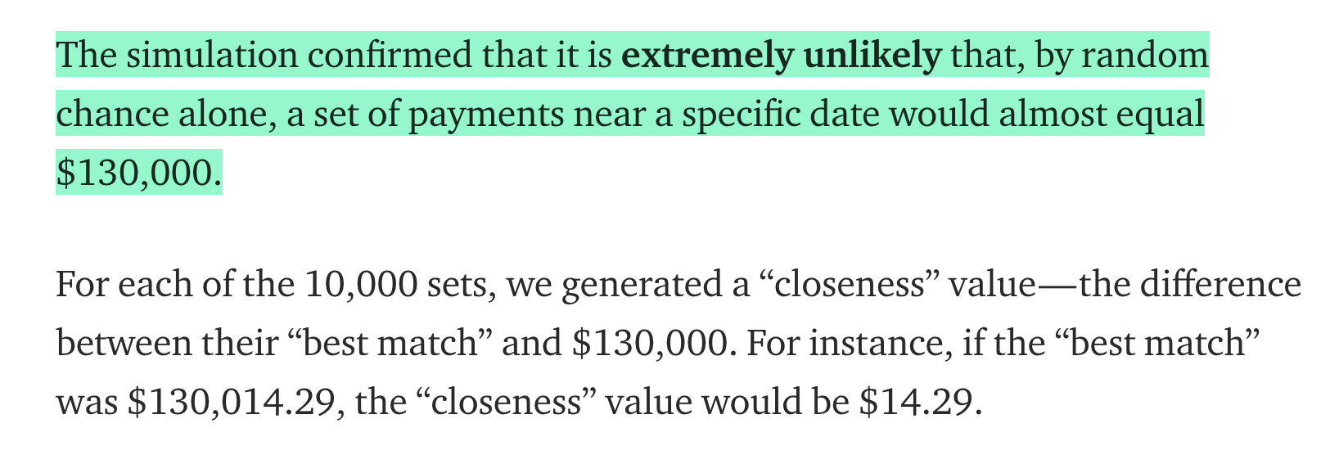
Randomization to detect secret payments?
Statistical Model Strongly Suggests the Stormy Daniels Payoff Came from the Trump Campaign,
Will Stancil
Notes:
https://medium.com/@whstancil/statistical-model-strongly-suggests-the-stormy-daniels-payoff-came-from-the-trump-campaign-7c09c300cb18

